Slide 1
Zines
Things you might not need to know

Slide 2
A brief history of zines
- Underground Press: One could argue that in their loosest form zines exist since people began to write, copy and self-publish. Zines stand in this long tradition of self-publication. Historically, they could even be traced back to 1517 when Martin Luther published his "zine", the "Ninety-five Theses," a time when Johannes Gutenberg had just invented the printing press and self-publication began to spread. Self-publication has always been a political medium and frequently used to express resistance, for example during the French Revolution. - Art, Artists' Books, and Mail Art: Self-publishing has been a method closely associated with several art movements in the 20th century. In journals, magazines, leaflets, and mail-art, Dadaist, Surrealist, Fluxus and Situationist artists employed techniques such as collages, bricolages, and detournment of magazine images and had a strong influence on zine editors later on. Since the 1990s, many young artists use zines to create their own creative spaces, distribution networks and audiences independent of the established gallery and exhibit system. - Science Fiction Fanzines (1930-1960). As a distinct form, zines originated in the 1930's in the United States when fans of science fiction began to publish and trade their own stories. The term "fanzine" became recognized as the abbreviation of "fan magazine" and later on was shortened to "zine." - Punk Zines: In the 1970s, when punk rock music emerged, the Do-It-Yourself (DIY) ethos found a fertile ground in zines. This ethos combined with the increasing accessibility of photocopy technology fueled an explosion of zines. - (Riot) Grrrl Zines: When in 1991 the riot grrrl movement emerged out of the alternative and punk music scene in the United States, thousands of young women began to produce personal and political zines with explicitly feminist themes. Bikini Kill called in their manifesto upon young women to form bands, to mutually learn and teach instruments and to publish zines. Nowadays, some women ("grrrls") who grew out of the riot grrrl movement have chosen to reclaim the title and call themselves "ladies." Their politics remain devoted to assertive feminism and activism. - E-Zines: During the 1990s the zine network expanded enormously into the realm of e-zines. In addition to the typical objectives, these online zines serve often as resource and network sites. But although the Internet makes e-zines available worldwide and allows geographically isolated people to correspond, one should not forget that it is still a privilege to have access to computer-technology.

Slide 3
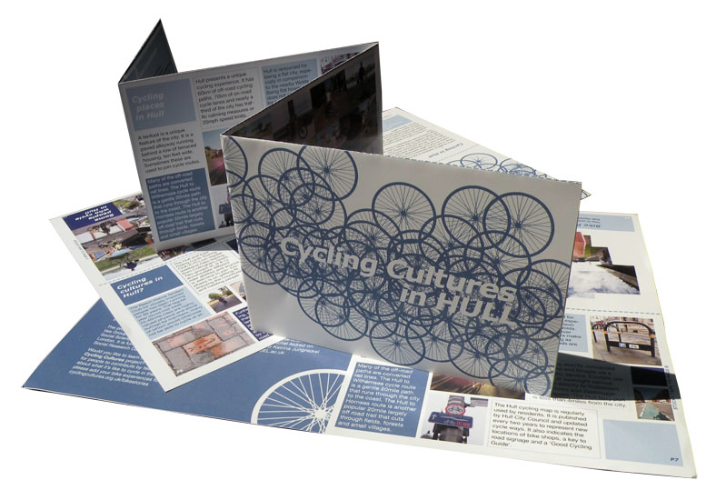
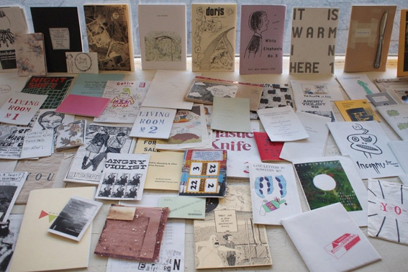
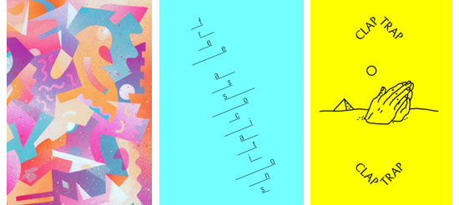

Slide 4
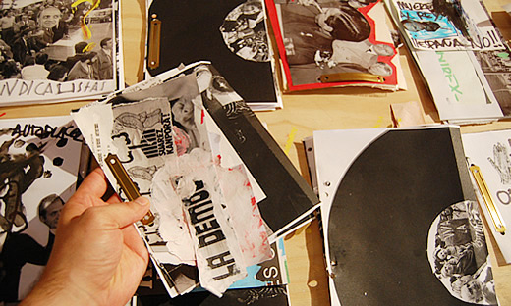

Slide 5
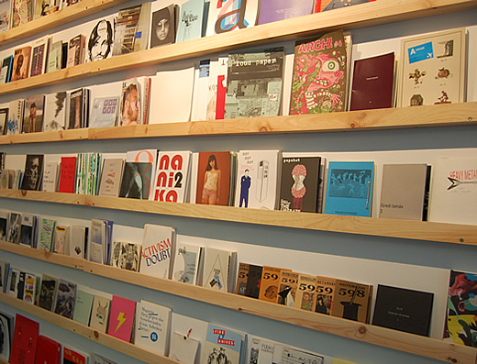
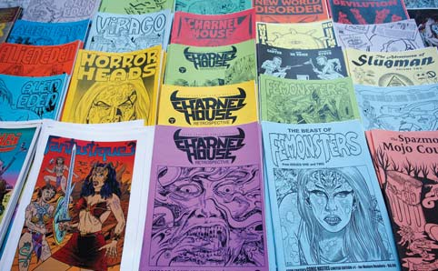
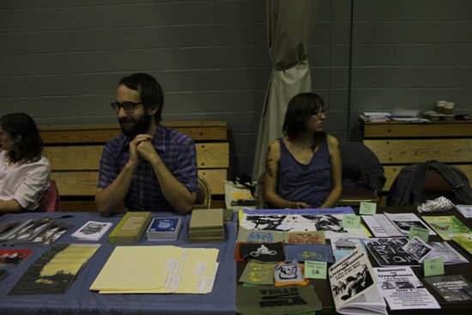

Slide 6
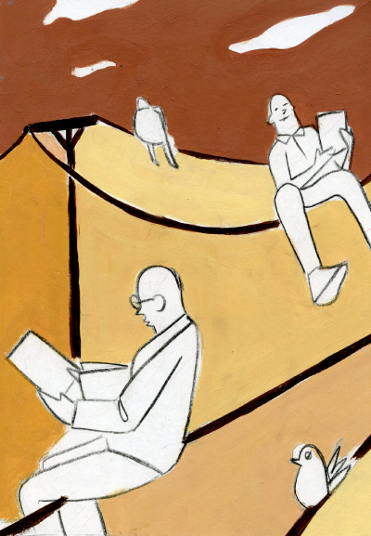
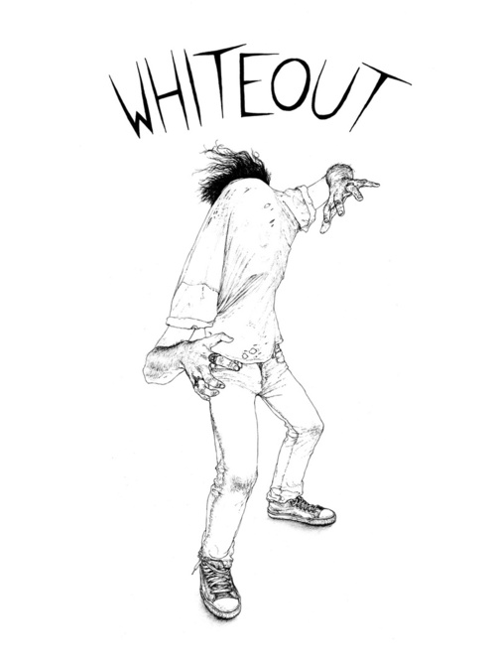
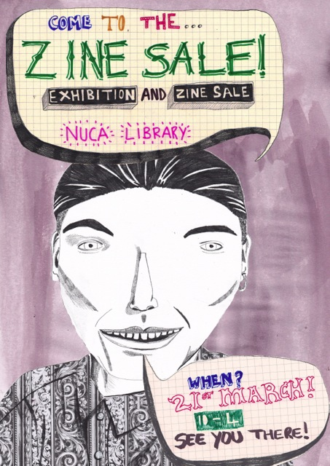

Slide 7
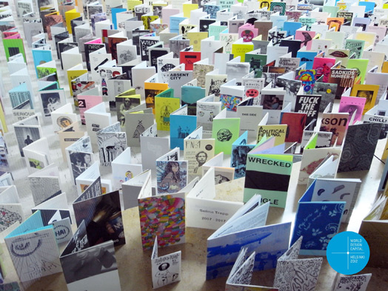

Slide 8
An Australian perspective
For the uninitiated, zines are broadly defined as being “photocopied, small scale self-publications,” explains Eloise Peace of Melbourne zine store Sticky. But herein lies the difficulty in characterising zines overall because “some of the most popular zines aren’t in book format. They more closely resemble magazines, letters or origami.”
For instance, a zine called You is an in-store favourite; a weekly, photocopied, double-sided A4 letter that comes in a stapled paper bag. “It’s been issued for free for five years,” says Eloise. “It’s distributed anonymously. Sometimes one person writes it, sometimes people collaborate.” Paper/cuts is another weekly zine with a devoted following. Thanks to ingenuity, patience, and a little bit of sticky tape, Paper/cuts acts as a handy wallet for your cash – that readers literally use week to week. “Once the week’s up, people unfold the wallet to view amazing artwork, secret letters and conversations of things,” says Eloise, “but only after they’re picked up next week’s issue!” Other long-held favourites come in traditional booklet form, such as The Life and Times of Mavis McKenzie and Erinsborough Exploits. “The Life and Times of Mavis McKenzie is a 10-year-old zine that details the life of a fictional elderly lady,” says Eloise, laughing. “The character’s based on an 80-year-old grandmother from the suburbs, and the zine is about her gripes with the modern world – such as the green man not flashing for long enough at traffic lights. Edinsborough Exploits is a satire of TV show Neighbours. They’re both hilarious.”
Anna Poletti agrees that what constitutes a zine in Australia is diverse. She recently spent four years researching autobiographical writing within zines, as part of an English PhD at the University of Newcastle. She says that on a sub-cultural level “a zine is what someone says it is.” She backs this up with her experience at a zine fair a few years ago (an event where zine creators and readers gathered to buy and trade publications). One guy had hand-bound blank serviettes as a notebook, to trade for zines. His concept was a play on the idea that when a good idea strikes, the only thing you have to write on is a napkin. “That particular example was a zine, even though it didn’t contain content, nor was it photocopied,” says Anna. Rather, it qualified as a zine because it conveyed an idea in a do-it-yourself format – and because people accepted it as being a zine.
Even when zines do contain content, there’s no defining writing style. “Most people who create zines write from a personal perspective,” says Anna. “There are exceptions to this, but overall zine writing is usually motivated by passion and interest, rather than professional gain or career direction. It’s a DIY labour of love; a creative, fun outlet to express yourself.”
Brisbane poet, Mandy Beaumont, makes zines for these reasons. “I’m really into the idea of saying what the hell I want to and getting it out there to people in a relatively short period of time, with small costs. I chuck my zines on café tables, in bars, and places where people pick ‘em up and take ‘em home. It's a simple exchange.” Hers is a pocket-sized zine, approximately half a B5 piece of paper. “I’m obsessed with the idea that one can carry poems around with them in their back pocket!” says Mandy, of the format of her zines. Her inspiration to create zines is two-fold; as a practical means to get her work out there, and an excuse to create more poetry. “My ongoing obsession with words means that any way I can get words out there … I will.

Slide 9
“Zines play a really important subversive role in contemporary society,” explains Eloise, “because they’re a powerful representation of what people are actually thinking. They’re a place for people to experiment and communicate, free from the restrictions of cross media ownership and overriding technology.” This is true for Mandy, who communicates her poetry to an audience in a way that’s intimate, unique, connective, and to the unsuspecting patron of the café, often surprising. It’s an economy of storytelling that allows zine makers to put together a lot of ideas in a short period of time and distribute these ideas, just as quickly. “I like promoting zines with really small print runs,” says Luke Sinclair, one of the founders of Sticky and a full-time artist of zines. “I get excited about zine creators pursuing lots of ideas quickly. Zines are a contradiction: they’re impermanent by nature, but they’re also amazing objects/stories/art that deserve to be put on the shelf.”
The ideas covered in zines helped spur Anna’s PhD research. Part of her research discovery is that zines offer a site – particularly for young people – to speak about personal experiences that might not be as readily accepted via other mediums. “The benefit of participating in the zine community is a strong network of support for readers and writers who are expressing themselves outside of institutionalised narration.”
Anna’s work saw her read through over 1000 personal zines, searching for recurrent narrative themes. Her inspiration was to find out if zine creators spoke about similar things in similar ways, and if so, what topics weren’t they talking about? Her work revealed zines as a tool people use to empower themselves and each other against issues like depression and displacement within institutionalised, mainstream society.
“With depression, people only get to talk about how they feel about particular aspects of their experience, in particular sorts of environments,” Anna details. “These environments come with the expectation that you won’t say certain things. Suicide fantasies for instance are usually a no-no. But because zines are largely anonymous, I found explicit, extensive discussion on suicide and dying, with narratives on how people want to die.”
Her interpretation of this recurrent theme is that the zine community is a safe and secure environment for discussion of any topic – taboo or otherwise – without interference or ramifications. “I think this is enormously beneficial for young people,” says Anna. “When you’re just out of home, or are in your late teens, most encounters you have are where you’re in a submissive role; whether it’s dealing with Centrelink, university, or school. Zines and the zine community benefit people in that they provide a free space of empowerment, and a support network of shared experiences.”

Slide 10
This emphasis on personal narrative wasn’t always so, with many Australian zines concentrating on independent music, lifestyle and political movements in the 70s, 80s and 90s. “The 90s was all about music zines,” states Luke, who first got into zines in the early 90s. “When I went to make my first zine with friends, it was a parody of music zines, with band interviews, reviews, new releases etc. That’s what I initially thought zines where about. Now, independent music communities have moved away from zines to the Internet. A lot of people thought the Internet would kill all zines, but the culture is as much alive today as it has ever been. It’s evolved. The volume of zines coming through Sticky has been consistent since we opened six years ago. One thing I did anticipate from the Internet and the popularity of blogging was more cross-over of the mediums, but that hasn’t happened. I suppose the differences between blogging and zine-making are like the differences between making a film and writing a novel. They’re totally different.”
While the Internet hasn’t dinted the volume of zines being read and produced, Anna claims the influence of the Internet can’t be entirely discounted, because the diversity of people involved in zines has shifted. “Zines used to be the cheapest and easiest way to get information out to particular audiences,” she says. “Now, the access and ease of online publishing means a lot of music and political audiences that use to obtain information via zines go online. So the kinds of people involved in the zine community have shrunk. But a vast number of people still have a lot of energy for zines, largely because DIY culture is free from authority – including the omnipresence of the Internet. Today, zines are about embracing the aesthetic of right now – the content and the form of the zine work together to tell a story. Most of all, it’s about being involved and getting out there.”
Ref: http://www.artshub.com.au/au/news-article/opinions/publishing-and-writing/a-place-to-experiment-australian-zines-158762

Slide 11
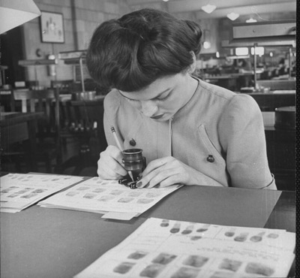
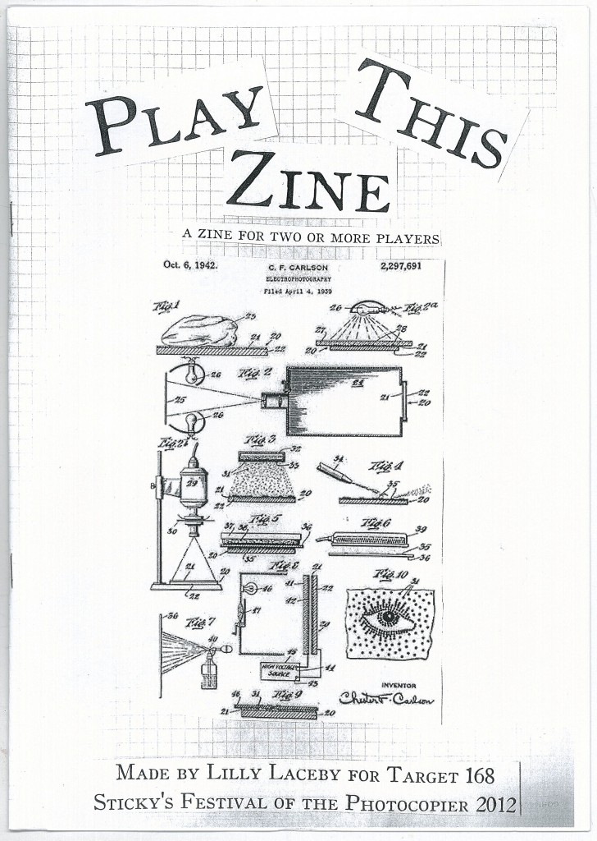
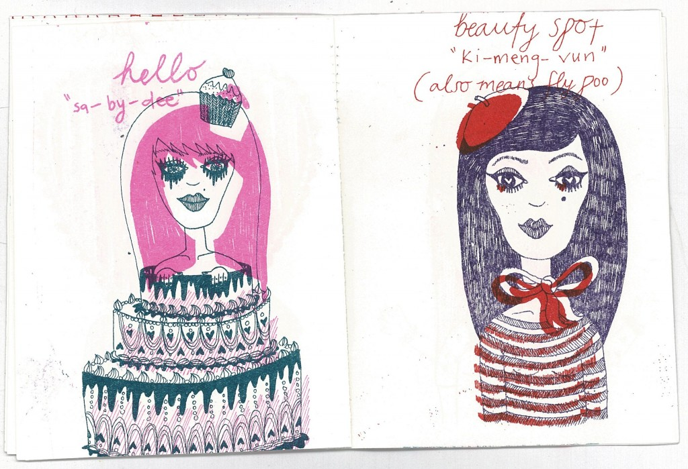
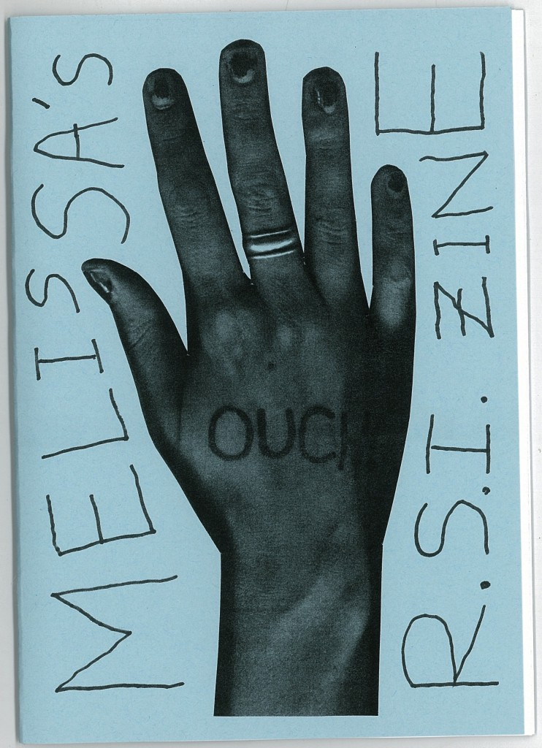

Slide 12
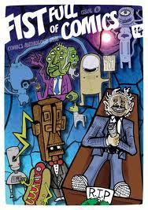
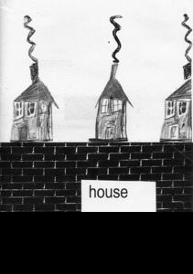
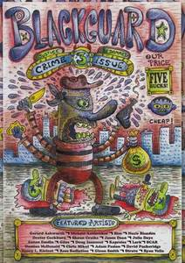
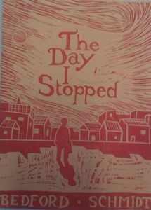

Slide 13
In the final analysis the main thing you need to remain mindful of during the development of
both digital and cut and paste versions of your publications is the need to be directed and focused while producing the works. Where you can; avoid the tendency to wander off topic or introduce too many random variables in both text and image types.

