Slide 1
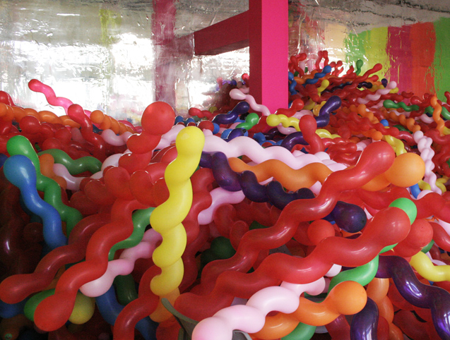
OBJECT

Slide 2
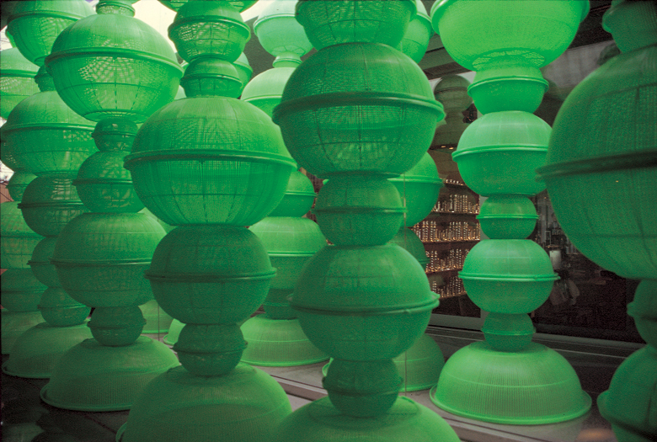
STACK
CHOI JEONG HWA, PLASTIC PARADISE, 1997

Slide 3
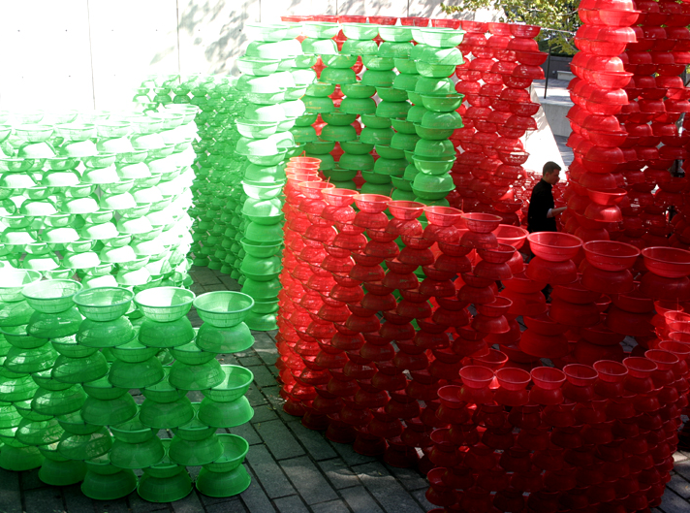
CHOI JEONG HWA, RED & GREEN, 2009

Slide 4
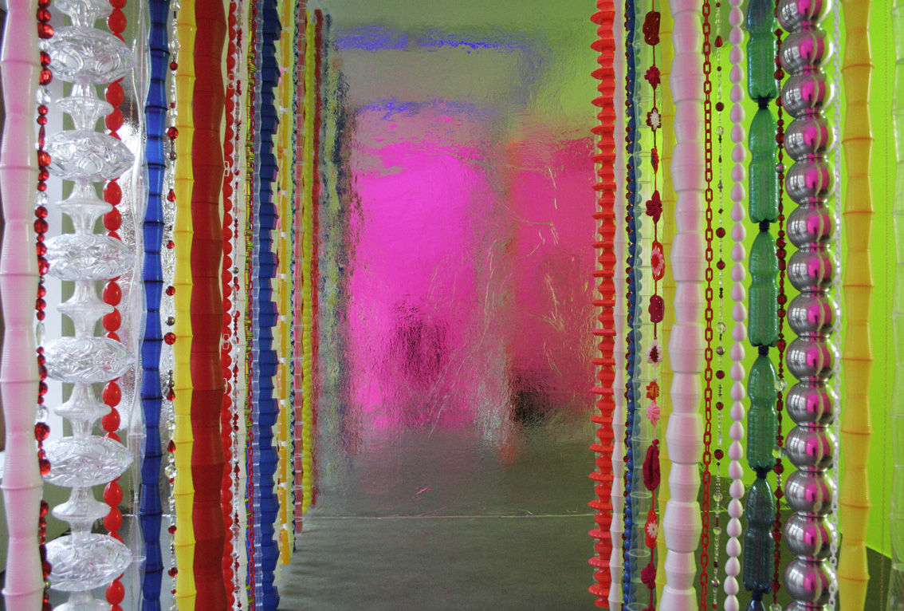
HANG
CHOI JEONG HWA, IN THE MOOD FOR LOVE, 2010

Slide 5
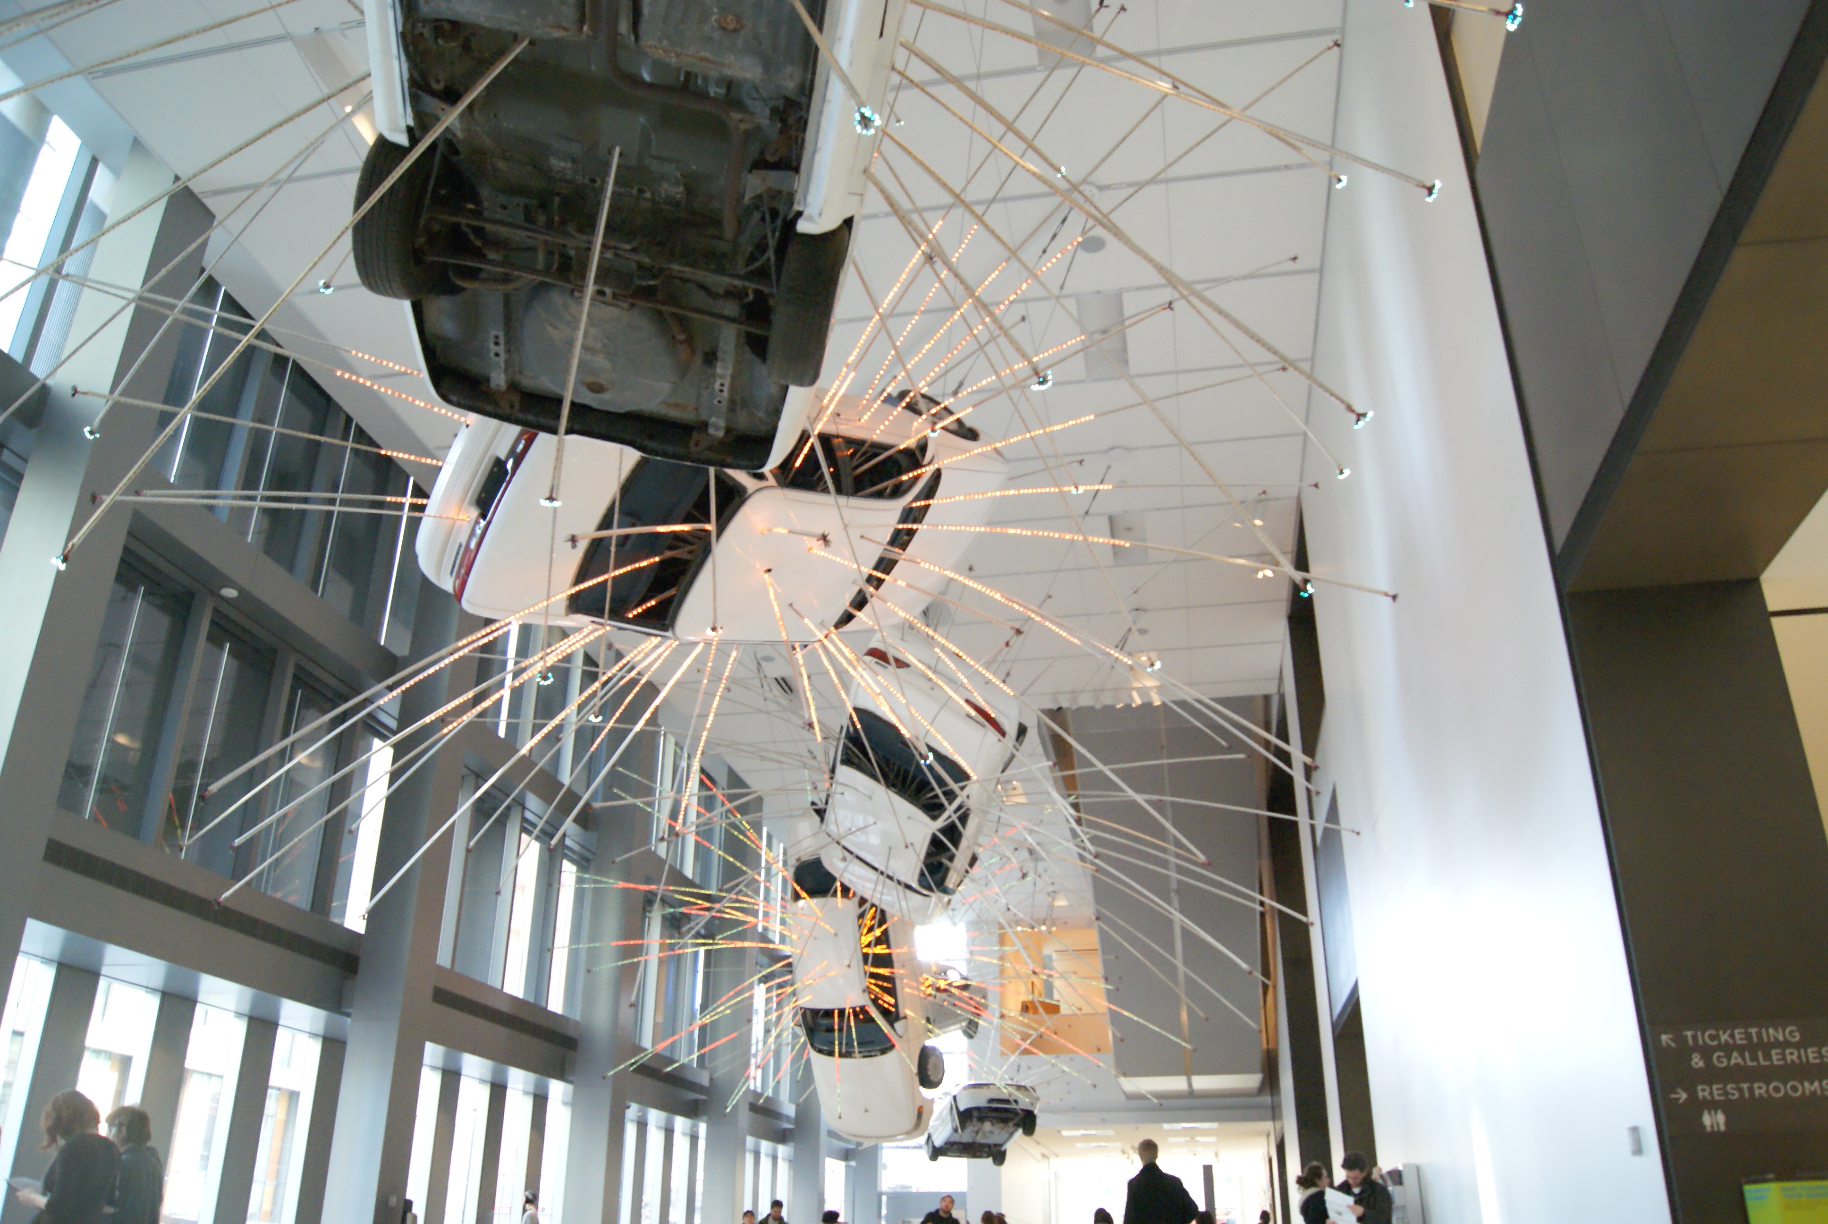
CAI GUO-QIANG, INOPPORTUNE, ONGOING

Slide 6
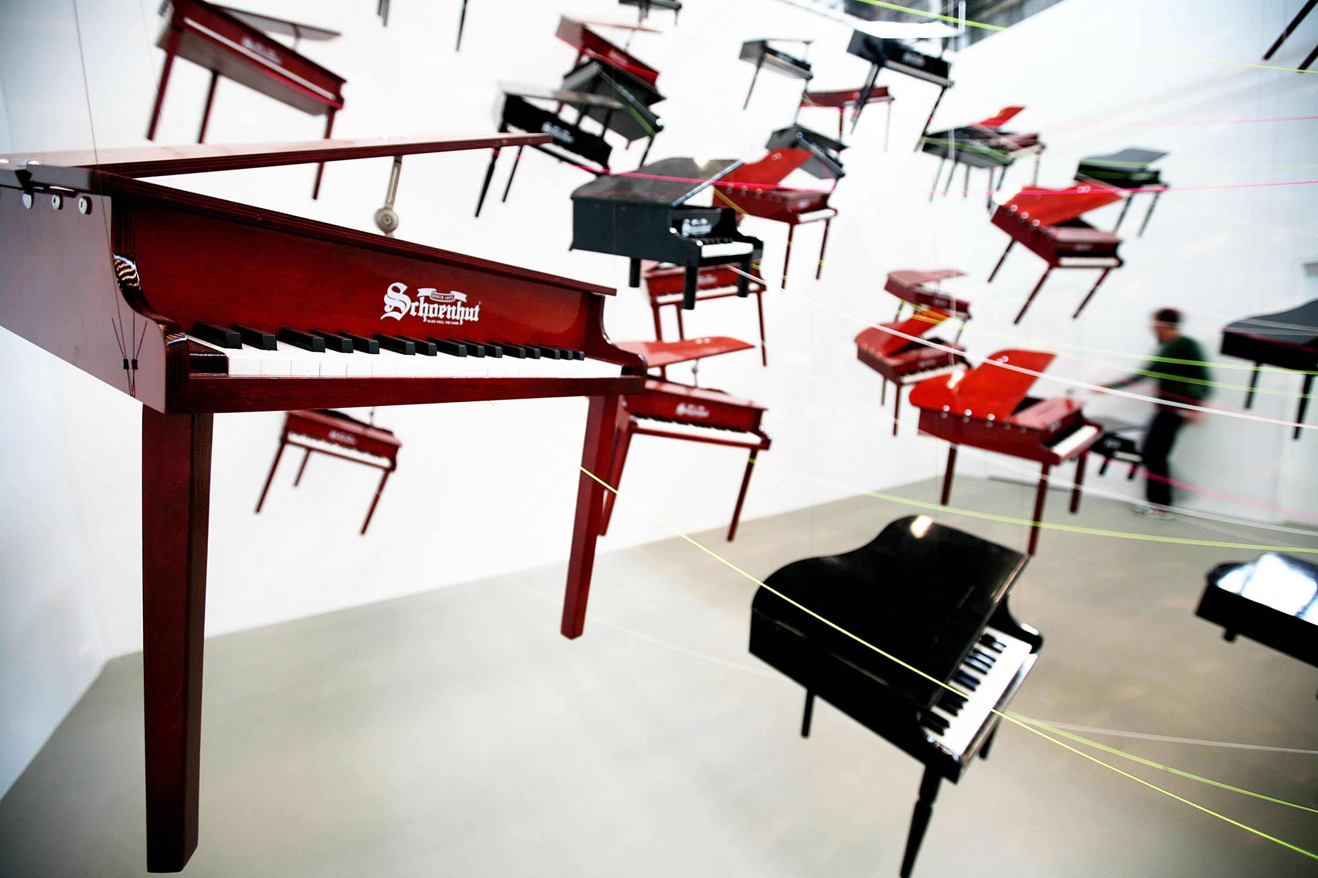
KEN UNSWORTH, A RINGING GLASS, 2009

Slide 7
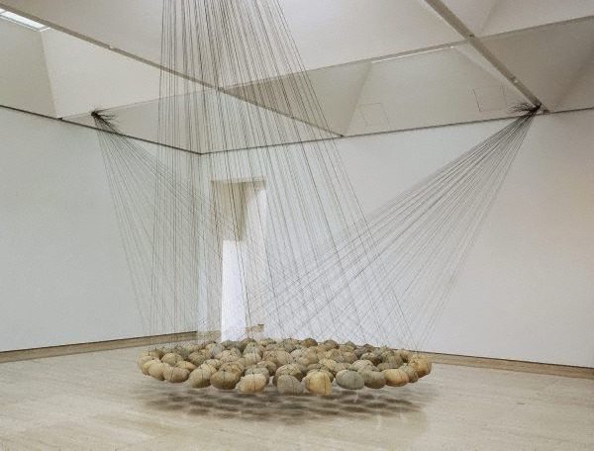
KEN UNSWORTH, SUSPENDED STONE CIRCLE II, 1974-77

Slide 8
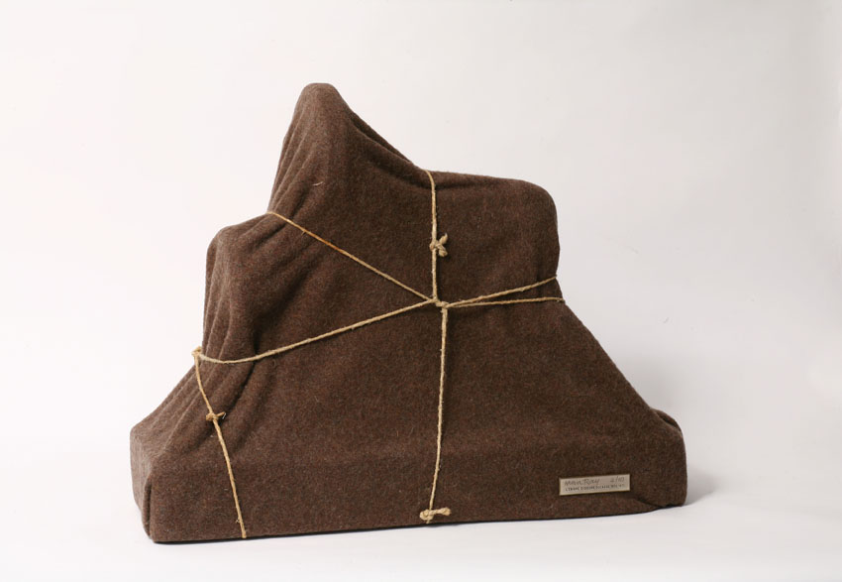
WRAP
MAN RAY, THE ENIGMA OF ISIDORE DUCASSE, 1920

Slide 9
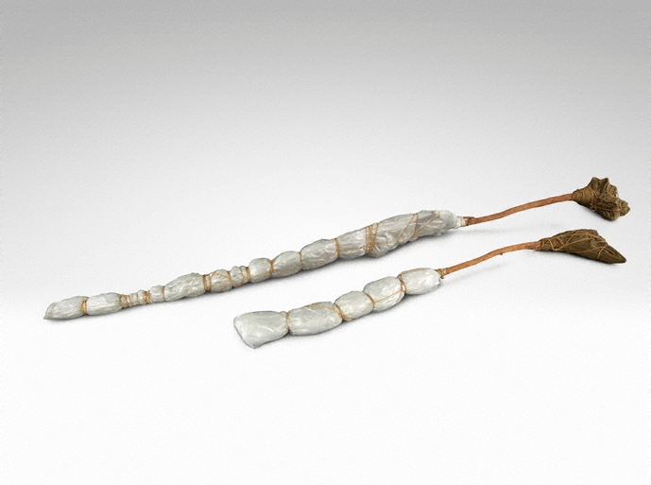
CHRISTO, TWO WRAPPED TREES, 1969

Slide 10
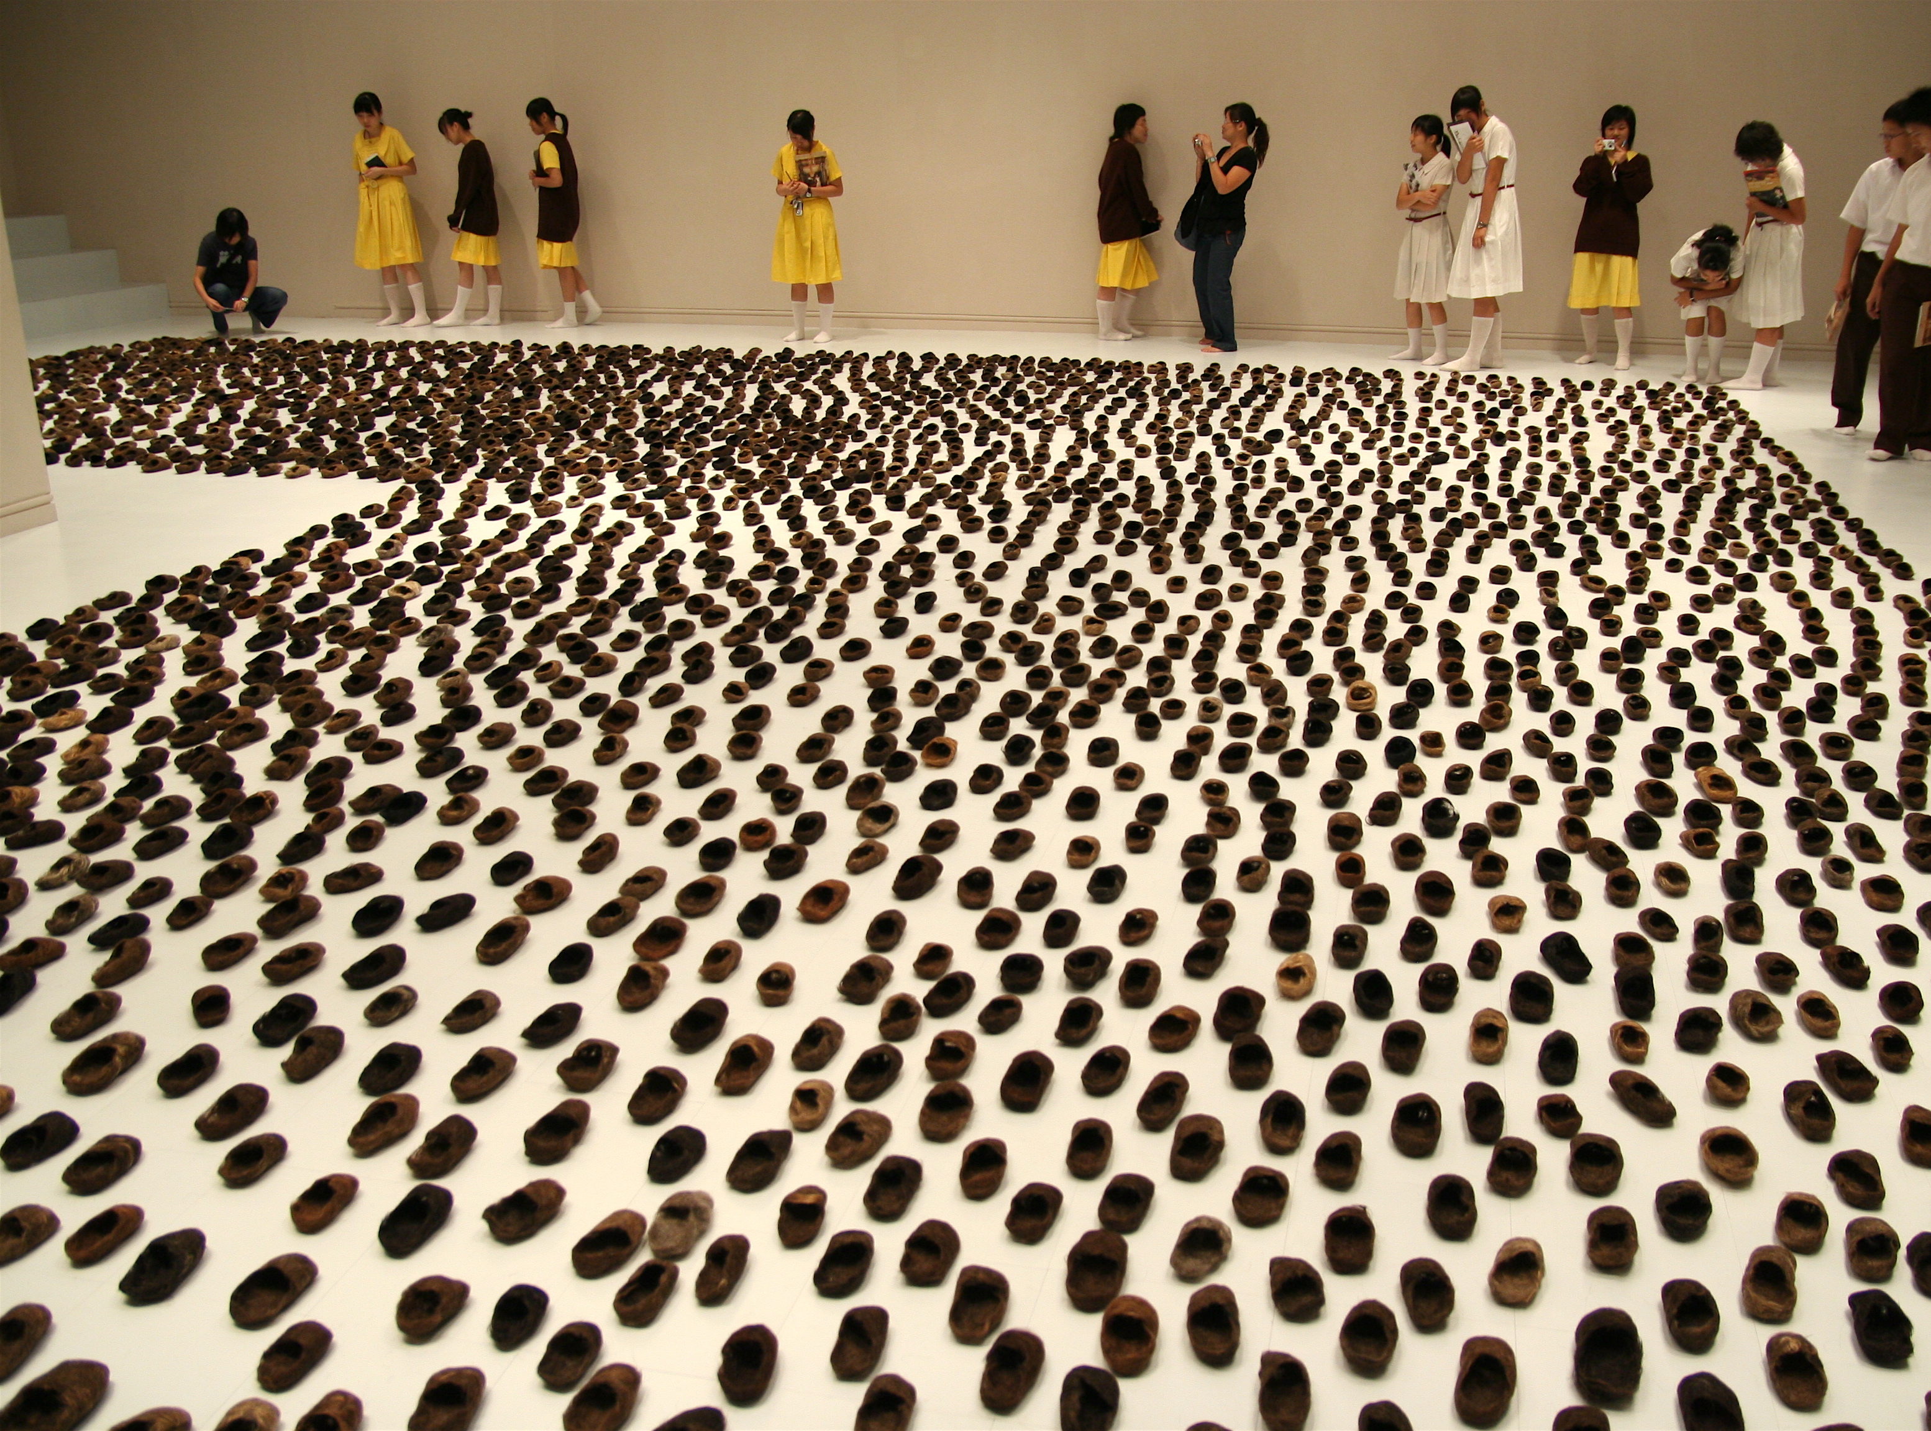
LEUNG MEE-PING, MEMORIZE THE FUTURE, 1998-2006
REPEAT

Slide 11
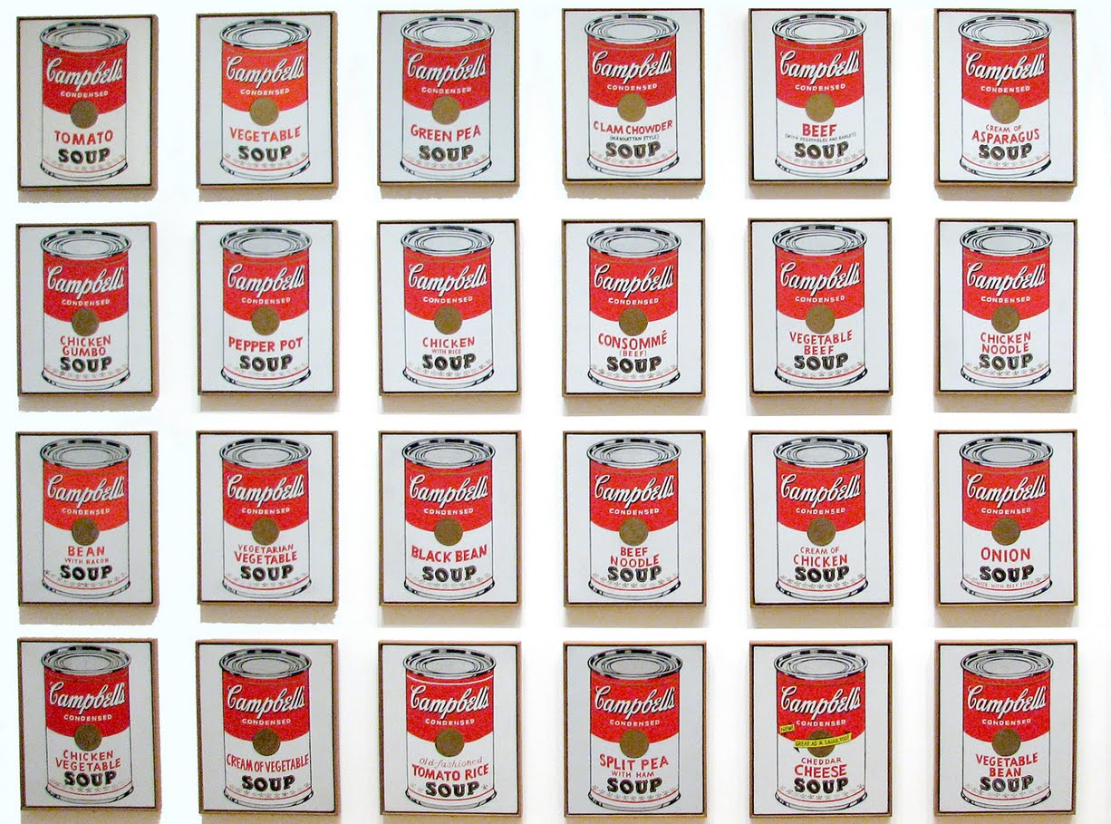
ANDY WARHOL, CAMPBELLS SOUP CANS, 1962

Slide 12
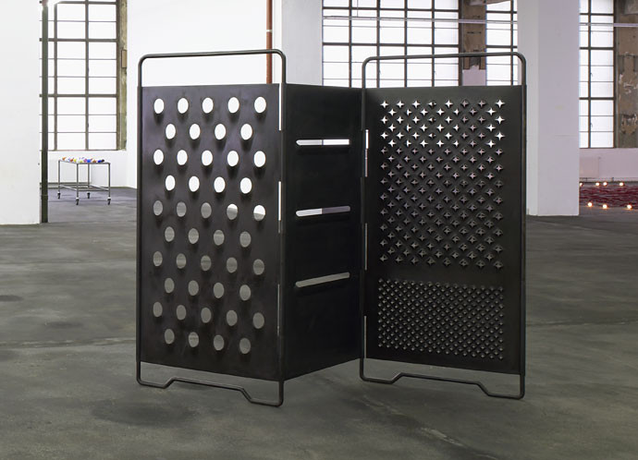
SCALE
MONA HATOUM, GRATER DIVIDE, 2002

Slide 13
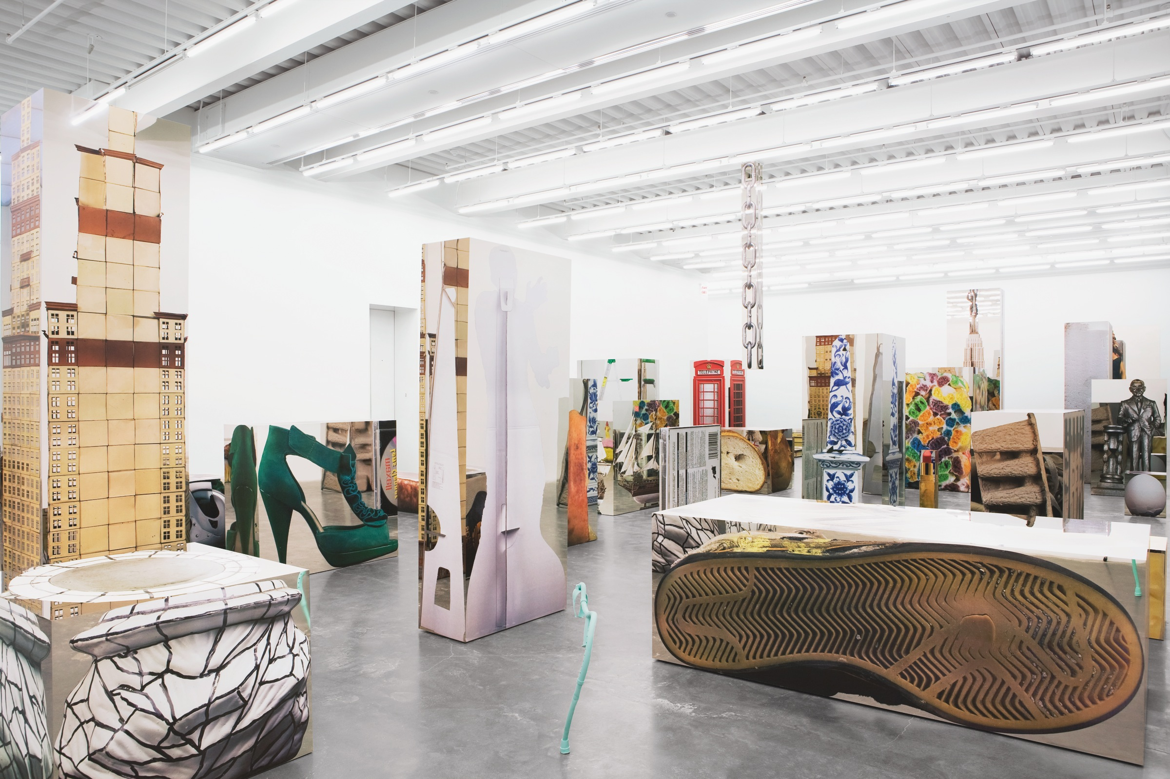
URS FISCHER, SERVICE à la FRANCAIS, 2009

Slide 14
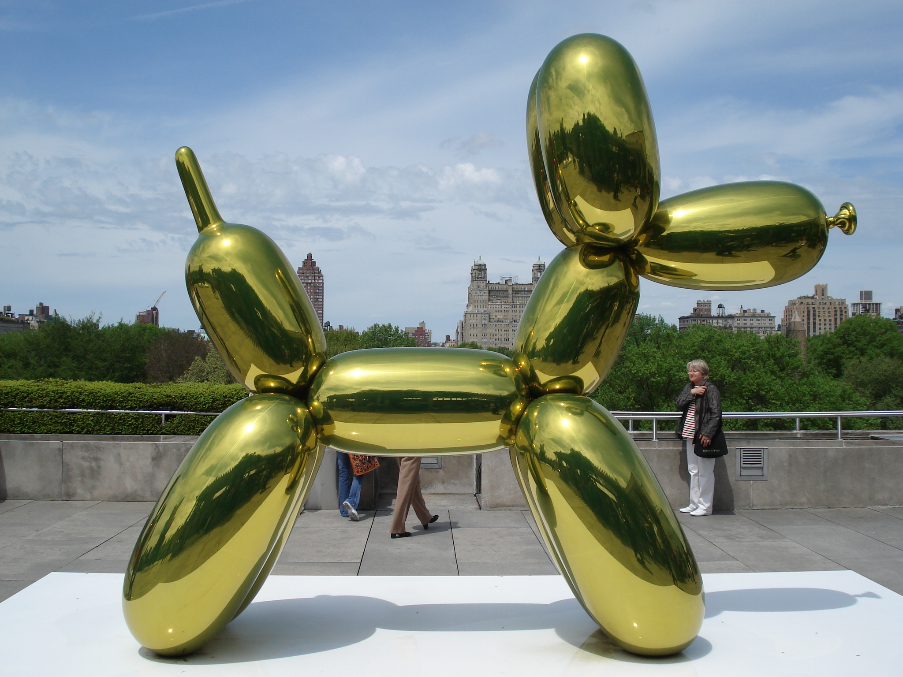
JEFF KOONS, BALLOON DOG (YELLOW), 1994-2000

Slide 15
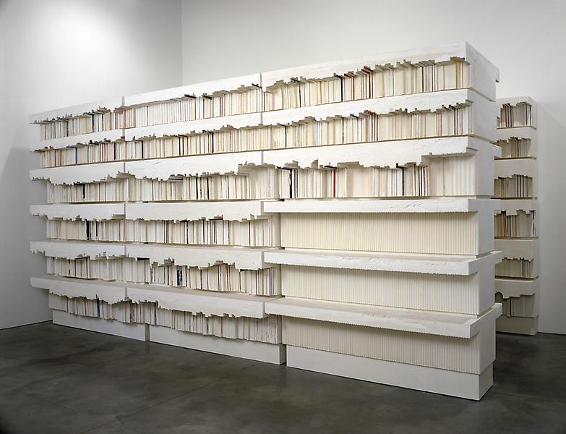
SPACE
RACHEL WHITEREAD, UNTITLED (LIBRARY), 1999

Slide 16
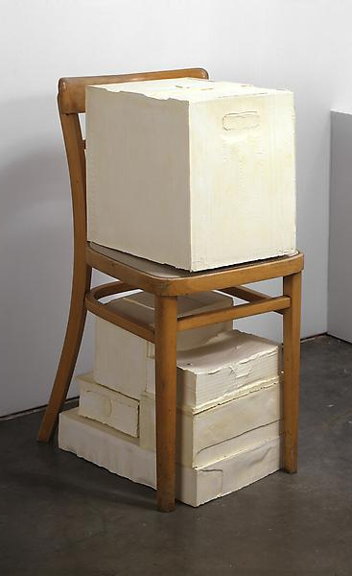
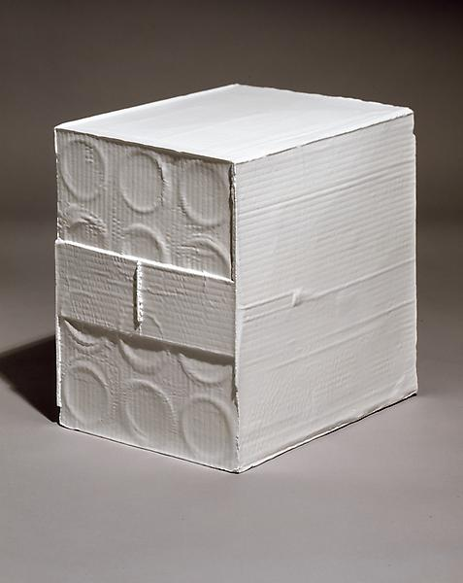
RACHEL WHITEREAD, WAIT, 2005
RACHEL WHITEREAD, WHITE BOX, 2006

Slide 17
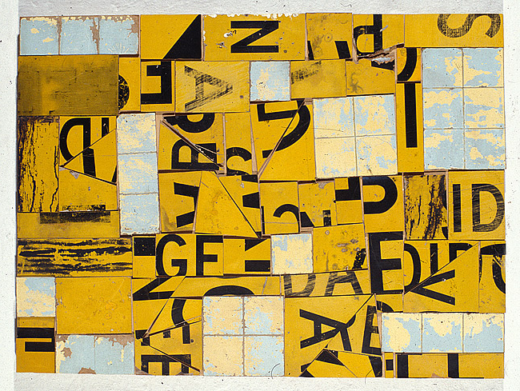
DECONSTRUCT
ROSALIE GASCOIGNE, SKYLIGHT, 1993

Slide 18
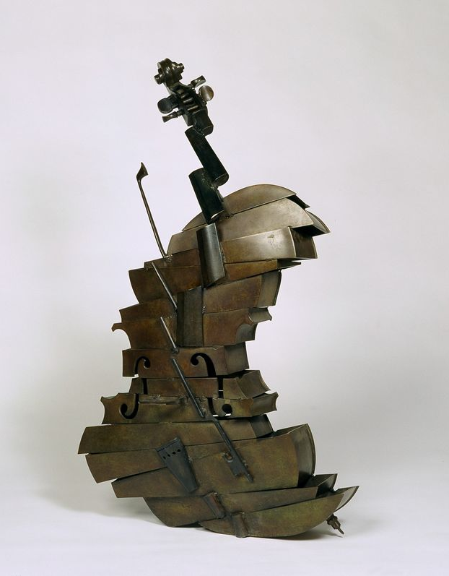
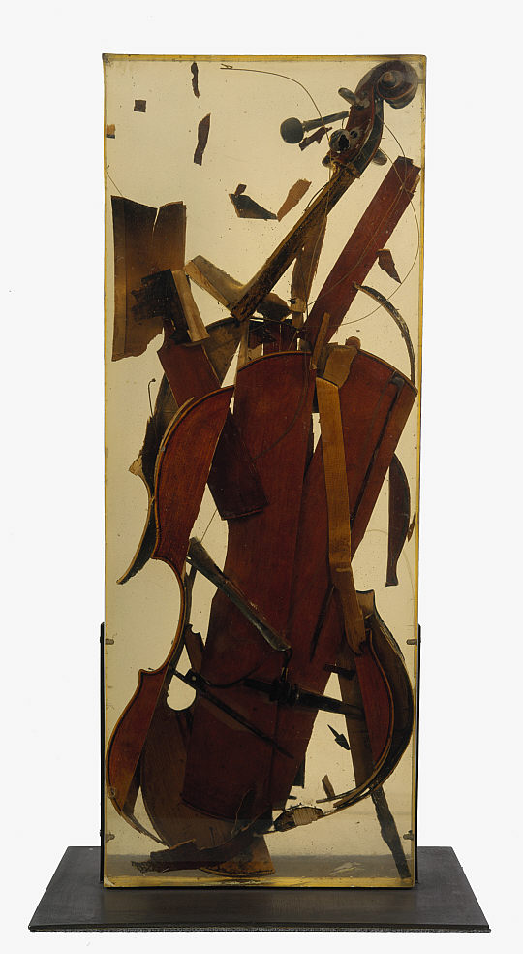
ARMAN, CELLOMASTER, 1961

Slide 19
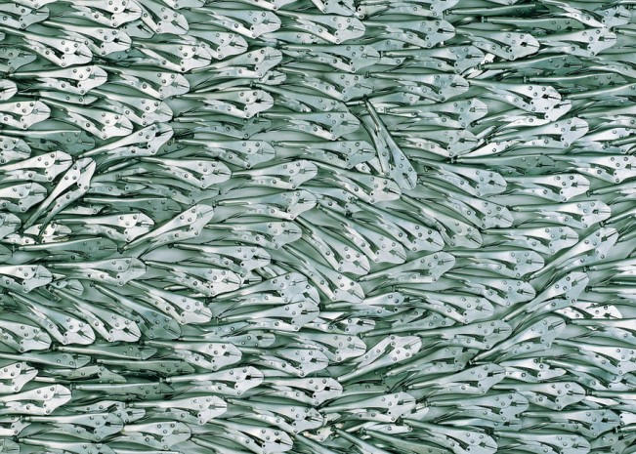
ASSEMBLE
ARMAN, SCHOOL OF FISHES, 1982

Slide 20
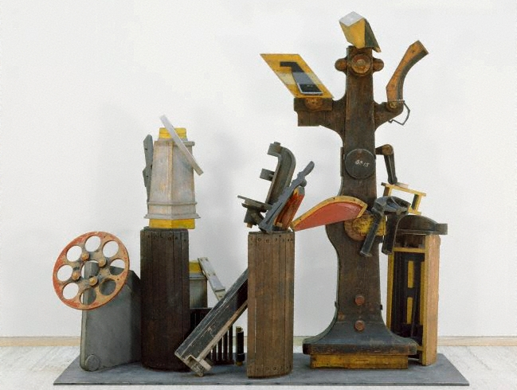
ROBERT KLIPPEL, NO 714 PROTOTYPE, 1988

Slide 21
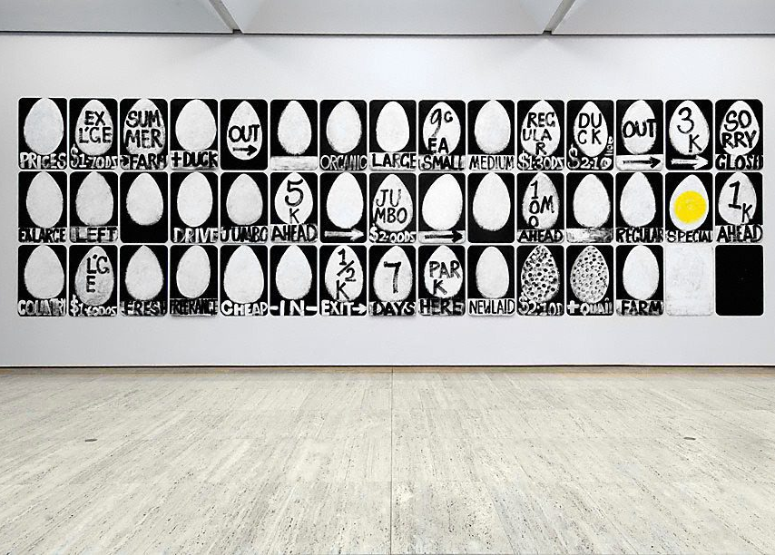
TEXT
ROBERT MACPHERSON, MAYFAIR SUMMER FARM, 1993

Slide 22
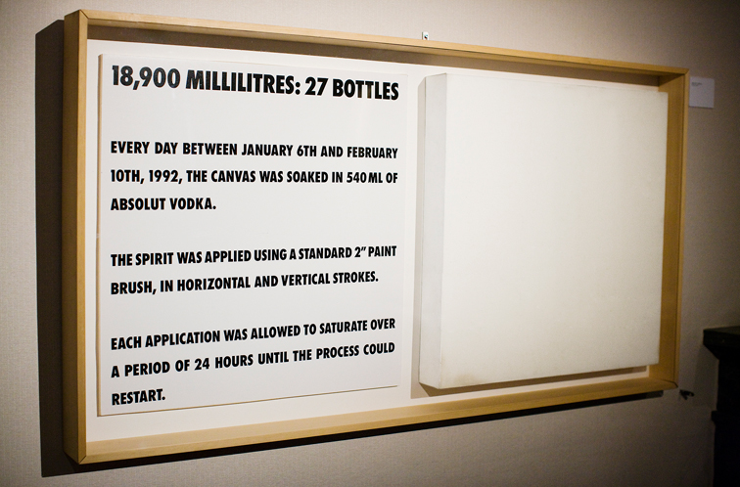
DOUGLAS GORDON FROM THE ABSOLUT ART COLLECTION

Slide 23
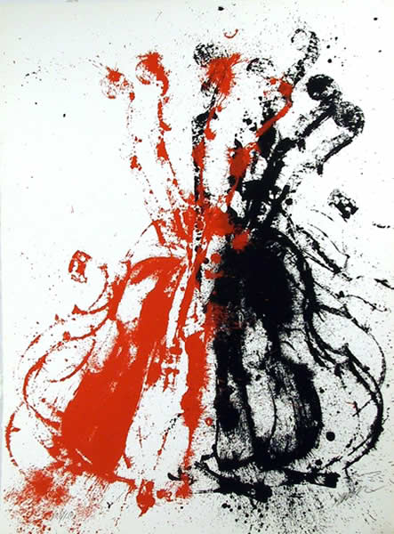
Notes:
Opportunity for student work – doing stamping with your object (we did experimental with knives and forks etc) and then collaging elements i.e. Klippel to create imaginary structures (again did a printout with knives and forks etc)

